Slide 1


Impact of Science Conference the Roundtable on:
National Impact Evaluation Frameworks
24th June, 2021

Slide 2


Impact of Science
23-25 June, 2021
Marta Wroblewska: Chief Expert at National Centre for Research and Development, Poland
Igor Campillo: Director of Euskampus Fundazioa, Basque Country, Spain
Gerhard Moolman: Director of Information & Analysis, National Research Foundation, South Africa
Overview of the Speakers
#IOS21

Slide 3
Impact of Science
23-25 June, 2021
Marta Wroblewska
Chief Expert at National Centre for Research and Development, Poland
#IOS21

Slide 4
National Impact Evaluation Frameworks
UK, Norway, Poland
Marta Wróblewska
Impact of Science 2021 South Africa, Cape Town | 24.06.2021 r.

Slide 5

Impact evaluation: UK, Norway, Poland
The National Centre for Research and Development
Systems compared:
UK: Research Excellence Framework (REF) – since 2014
Norway: Humeval 2015-2017
Poland: Ewaluacji Jakości Działalności Naukowej (Evaluation of Quality of Scientific Activity) – 2017-2020 (to be run for first time in 2022)
Sources:
Wróblewska, M. N. (2019). Impact evaluation in Norway and in the UK – a comparative study based on REF 2014 and Humeval 2015-2017. ENRESSH Working Paper Series, DOI: 10.3990/4.2666-0776.2019.01
Wróblewska, M. N. (2021), "Research impact evaluation and academic discourse". Humanities and Social Sciences Communications, 2021, 8 (58). 2021, doi: 10.1057/s41599-021-00727-8

Slide 6
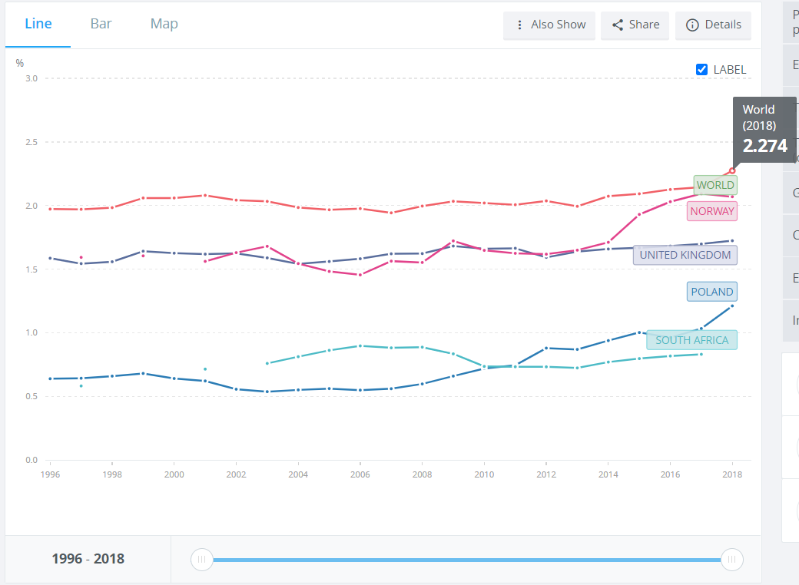
R&D spending as % of GDP
The National Centre for Research and Development
Source: data.worldbank.org 21.06.2021

Slide 7
Science systems & Evaluation strategies
  United Kingdom
  Investment in R&D: 1.72% GDP (2018) to increase to 2.4% in 2027, longer term 3%
  Number of researchers per m inhabitants: 4,254
  Considered ‘central’ science system
  Single, expert-review driven evaluation system (REF) which is basis for funding distribution
  Norway:
  Investment in R&D : 2.07% GDP (20% increase from 2011)
  Number of researchers per m inhabitants: 5,687
  Complex system of evaluation, using different methodologies, mainly formative
  Poland:
  Investment in R&D : 1.21% GDP(20% increase from 2011)
  Number of researchers per m inhabitants: 2,053
  Mixed „parametric” approach to science evaluation

Slide 8
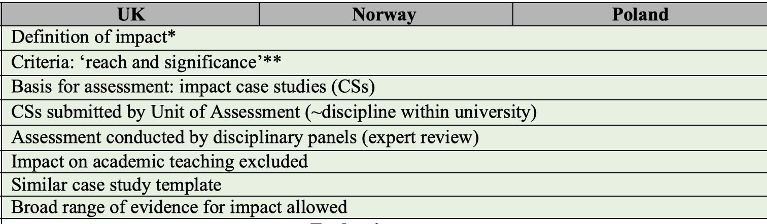
Evaluation of impact – similarities

Slide 9
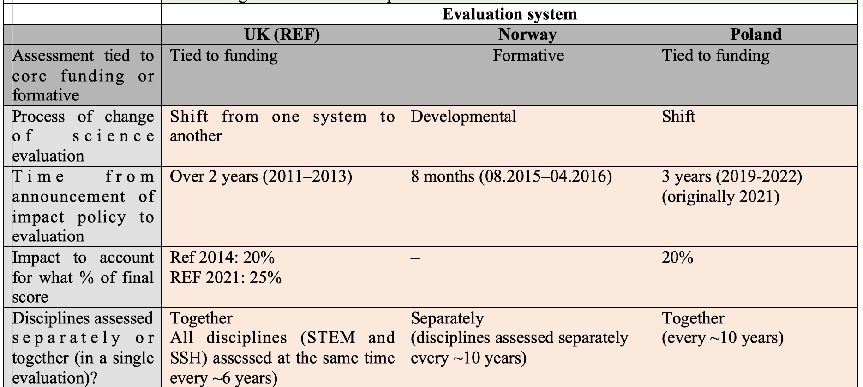
Differences: evaluation system

Slide 10
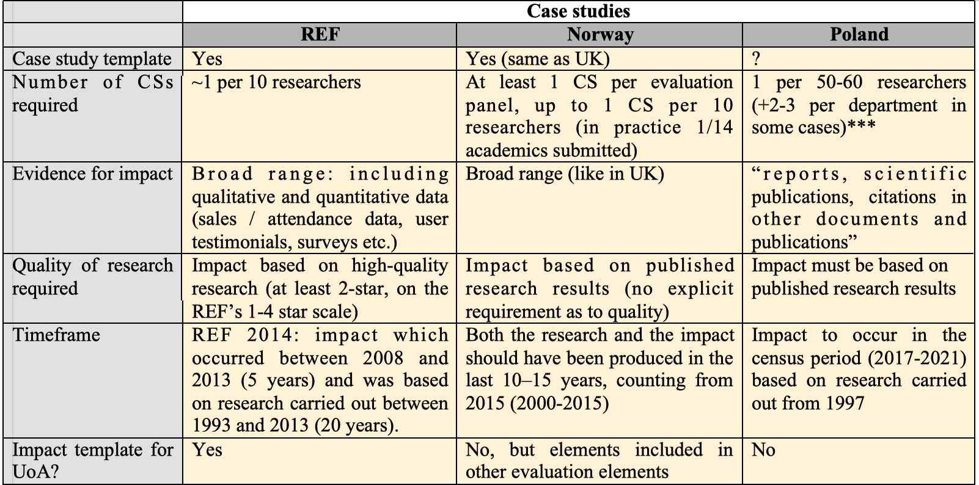
Differences: case studies

Slide 11
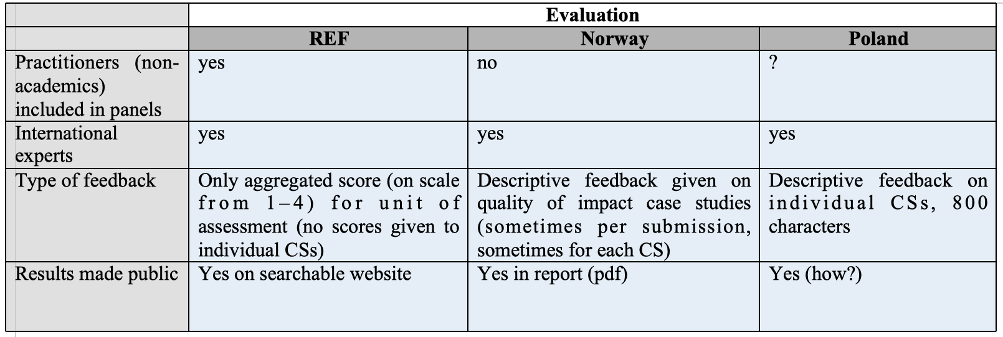
Evaluation of impact – differences

Slide 12
Impact of Science
23-25 June, 2021
Igor Campillo
Director of Euskampus Fundazioa, Basque Country, Spain
#IOS21

Slide 13




Impact of Science 2021, hosted from Cape Town, South Africa
National Impact Evaluation Frameworks (Roundtable)
23-25 June 2021
Basque Country, Spain
Igor Campillo

Slide 14
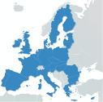
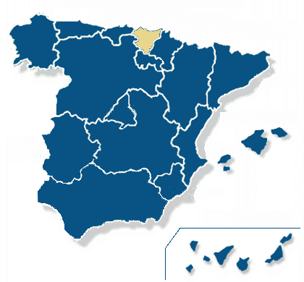
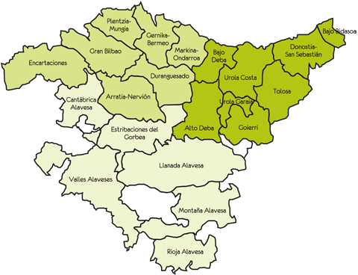
The Basque Country
Population: 2.2 million
GDP per capita: €35,300 (Euskadi)
€29,200 (Eurozone)
Industry GDP: 25,4% (Euskadi)
24,5% (Eurozone)
R&D expense: 1,9% GDP (Euskadi)
  2.1% GDP (Eurozone)
Unemployment rate: 9,6% (Euskadi)
14% (Spain)
7,7% (Eurozone)

Slide 15
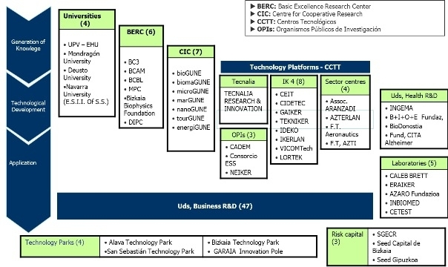
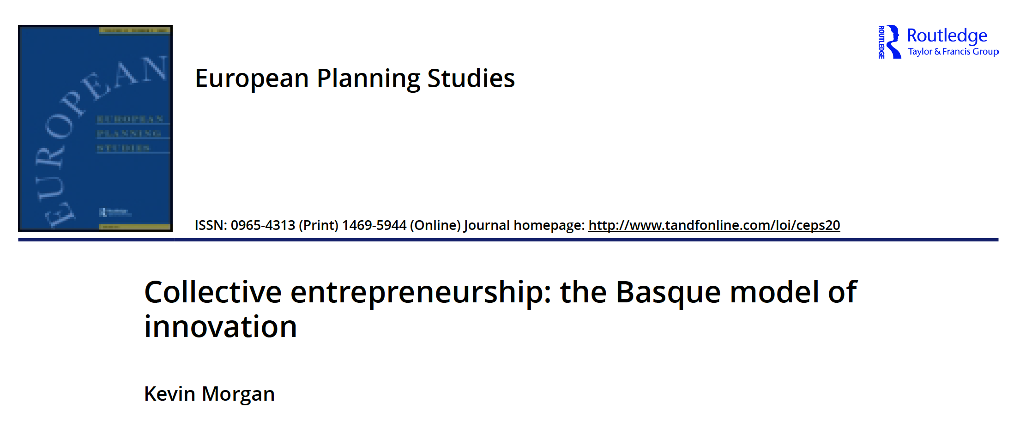
1980s
Capacity
building
1990s
Industrial orientation
2000s
Sectoral diversification
2015 - ...
Smart specialisation
A very dense R&I Ecosystem
Technolgy
Centers
Sectoral
Clusters
CICs, BERCs
Ikerbasque
Innobasque
…

Slide 16

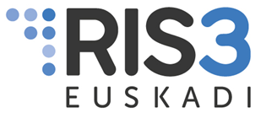
Euskadi 2030 Science, Technology and Innovation Plan
- 2030 STIP -
A Smart Specialization Strategy

Slide 17
Vision 2030
The Basque Country is among the most advanced European regions in innovation in 2030, with a high standard of living and job quality

Slide 18
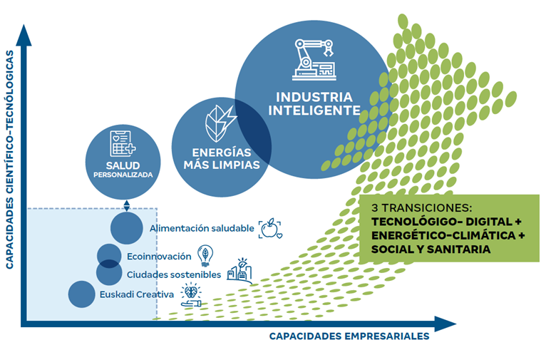
RIS3 areas
SMART
INDUSTRY
Cleaner ENERGIES
Personalised HEALTH
SCIENTIFIC-TECHNOLOGICAL CAPABILITIES
3 TRANSITIONS:
TECHNOLOGICAL-DIGITAL
ENERGY-CLIMATE
SOCIAL AND HEALTH
Healthy food
Ecoinnovation
Sustainable cities
Creative Euskadi
BUSINESS CAPABILITIES

Slide 19
Monitoring and evaluation
A comprehensive monitoring and evaluation system
1. Evaluation of Strategy
(annual reports to monitor the progress of the STIP objectives)
2. Evaluation of Basque STI System
(biennial reports on the comparative situation of the System with Europe)
- STIP Dashboard -
- Position in RIS/EIS -

Slide 20
Evaluation of the Strategy
4 operational objectives , 8 measurement areas and 16 indicators
Objectives | Measurement areas | Indicator | Current status 2019 | Goal 2023 | Goal 2026 | Goal 2030
1. Maximize orientation of Basque R&D&I to results | Socioeconomic results | Knowledge intensive employment | 17,7% | 18,3% | 18,6% | 19,0%
 | Scientific and technological results | Top 10% world most cited scientific publications | 18,8% | 20% | 21% | 22%
 |  | High and medium-high technology product exports | 55,3% | 56% | 57% | 58%
 | Innovation results | Sales of new products as % of total sales | 18,3% | 19% | 19,5% | 20%
2. Promote R&D and innovation activity in companies, especially in SMEs | Activities and resources for innovation | Investment in R&D | 1.481M€ | 1.630M€ | 1.892M€ | 2.300M€
 |  | Investment in R&D financed by companies | 799M€ | 810M€ | 920M€ | 1.100M€
 |  | Innovative companies in product and / or business processes | 42,2% | 50% | 55% | 60%
 |  | Investments in innovation | 0,68% | 0,8% | 0,9% | 1,0%
 | Innovation protection | EPO patent applications | 194 | 220 | 240 | 260
 |  | European trademark applications | 465 | 600 | 700 | 800
 |  | European design applications | 125 | 155 | 185 | 225
- STIP Dashboard -

Slide 21
Evaluation of the Strategy
4 operational objectives , 8 measurement areas and 16 indicators
Objectives | Measurement areas | Indicator | Current status 2019 | Goal 2023 | Goal 2026 | Goal 2030
3. Promote internationali-sation of Basque R&D&I | International leadership and competitiveness | International financing of R&D | 128M€ | 145M€ | 170M€ | 200M€
 |  | Leadership in Horizon Europe projects | 27% | 20% | 20% | 20%
 |  | Basque companies participating in Horizon Europe | 77 | 100 | 110 | 120
 | Resultados de innovación | International scientific co-publications | 1.651 | 1.920 | 2.220 | 2.560
4. Promote scientific-technological talent, especially among women | Promotion of talent and new vocations | PhD researchers | 30,9% | 33% | 34% | 35%
 |  | Access to STEM undergraduate degrees | 29,1% 2020 | 31% | 33% | 35%
 | Gender equality and promotion of female researchers and technologists | Female researchers | 36,3% | 37,5% | 38,5% | 40,0%
- STIP Dashboard -

Slide 22
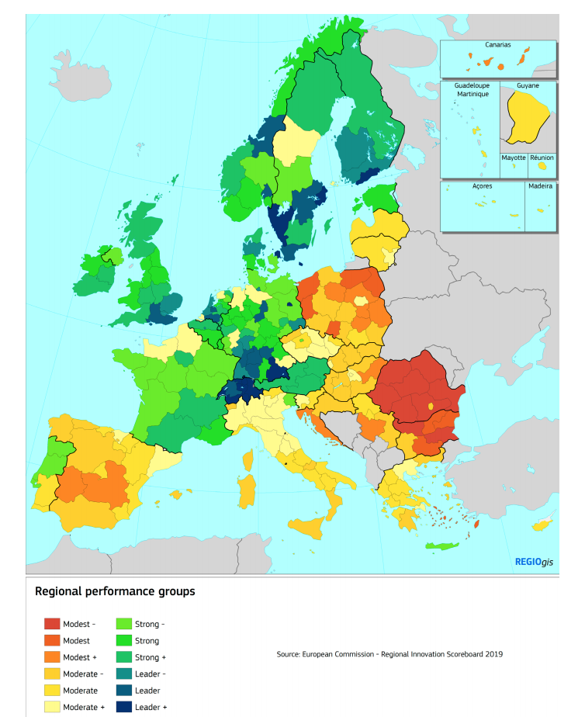
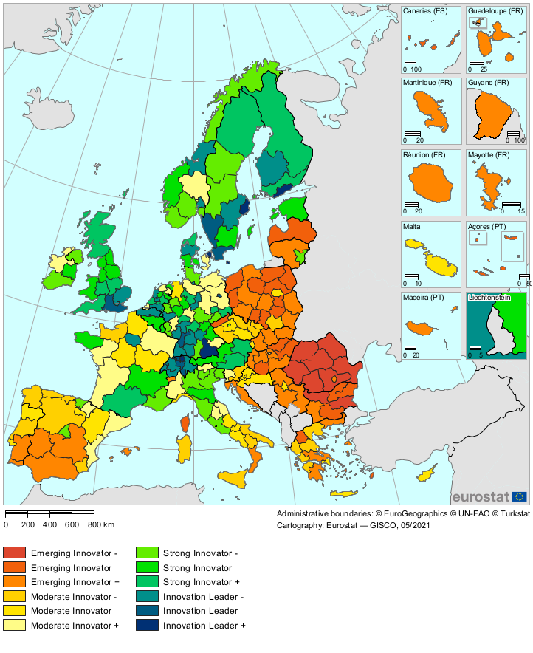
Evaluation of the Basque STI System
Position in Regional Innovation Scoreboard
2019
2021
Moderate Innovator
Strong Innovator

Slide 23


Conclusions
Excessive focus on output rather than outcome
Predominant narrative: economic development & growth
Focus on industrial innovation and technological development
Lack of a societal impact indicators in general
Low impact culture in institutions
Low impact literacy among researchers

Slide 24

“We shape the world by the questions we ask”
John A. Wheeler
What are we good AT?
What are we good FOR?
Which are the questions to ask if we want science to contribute to a more equitable, sustainable and prosperous future?
Shutterstock - photos

Slide 25
Impact of Science
23-25 June, 2021
Gerhard Moolman
Director of Information & Analysis, National Research Foundation, South Africa
#IOS21

Slide 26

IMPACT ASSESSMENT WITHIN THE IMPACT EVALUATION FRAMEWORK
AESIS Conference: Impact of Science – The Transformative Power of Research
23 – 25 June 2021
Gerhard Moolman
Director: Information and Analysis

Slide 27
NRF Mandate
The NRF’s mandate:
  supporting, promoting and advancing research and human capacity development, through funding and the provision of the necessary research infrastructure, in order to facilitate the creation of knowledge, innovation and development in all fields of science and technology, including humanities, social sciences and indigenous knowledge;
  developing, supporting and maintaining national research facilities;
  supporting and promoting public awareness of, and engagement with, science; and
  promoting the development and maintenance of the national science system and support of Government priorities.

Slide 28
NRF Impact Framework
Impact
A beneficial change in society or knowledge advancement, brought about as a direct or indirect result of the NRF’s research support interventions, whether planned or unintended; immediate or long-term.
Challenges
A resource constrained environment.
Research institutions and human capacity development needs are at different stages of maturity.
Fundamentals
Human capacity development and transformation are fundamental to our Impact Framework.
Pursue impact across all fields and disciplines and research methods.
Scientific rigour remains fundamental.

Slide 29
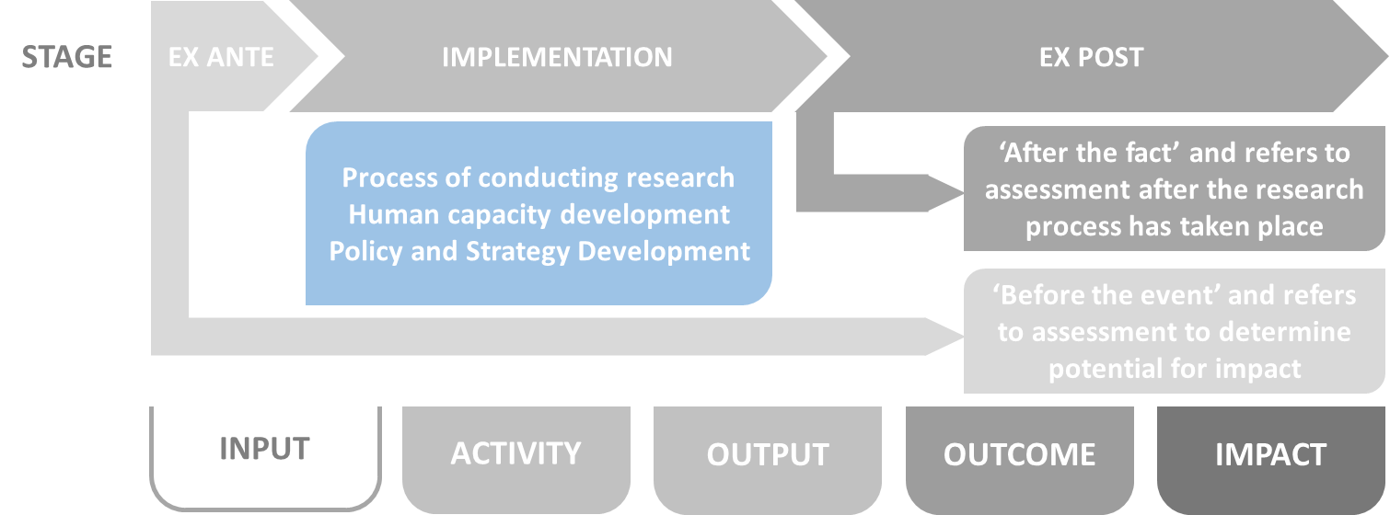
Stages of Assessment
Ex-ante - Planning for impact:
Ensure that the NRF’s processes, strategies and policies advance research impact.
Funded projects have potential for impact.
Ex-Post - Identification and communication of research impact stories
Identify where the NRF’s investments, and the research it has supported or carried out, have contributed to outcomes or impacts.
This stage is outside of our area of control.
Focus on demonstrating impact through case studies and relevant indicators, rather than to compare, evaluate, or measure research impact and attribution.
Case studies will rely on a variety of quantitative and qualitative assessment methodologies and indicators, taking the field and discipline into account.

Slide 30
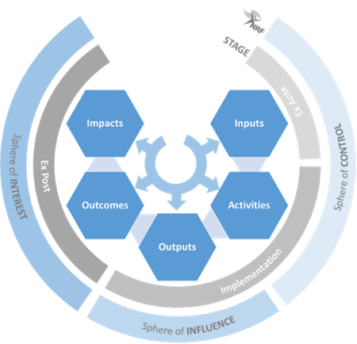
Impact Assessment throughout Impact Pathways

Slide 31
Pathway - Input Assessment
Inputs
NRF resources invested into the knowledge enterprise to support, promote and advance research impact.
Assessment will determine whether the NRF’s policies, strategies and plans regarding investment into the research sector align with & contribute to
National development,
National and international priorities, and
Responding to developmental challenges.
We will also assess whether investments (financial, human, infrastructure) are aligned to advance impact.
Ex-ante assessment of research proposals will assess the potential for impact.
Assessment may include, among others,
  Intended impact (an impact statement),
  Engagement and collaboration (engaged research statement with end-user involvement), and
  Transformation (who is involved in the project).

Slide 32
Pathway - Activity Assessment
Activities
Include any actions that directly or indirectly advance new knowledge, new applications of knowledge, innovation or human capacity development.
Assessment will focus on whether the NRF’s funding instruments, programmes, processes, incentives etc. are:
Aligned with the research impact agenda, and
Implemented taking potential impact into consideration.
Assessment could include progress reporting and surveys.
Periodic research progress reports to be used to determine whether planned engagements, collaborations and partnership activities with end-users occur.

Slide 33
Pathway - Output Assessment
Outputs
Research products, new knowledge, policy briefs and policy proposals, engagement, collaboration, methods, patents and skills produced as a result of the NRF’s inputs.
Analysis of human capacity development as well as research outputs taking Responsible Research Assessment (RRA) principles and practices into account.
Assessment will include:
Output counts.
Throughput rate, quantity and quality of students produced including demography.
Community interaction assessment.
Communication resources (articles, policy brief, exhibition, communication output etc.).
Partnership count and increased joint funding/ investment with partners.

Slide 34
Pathway - Outcome Assessment
Outcome
Application or use of outputs by the research enterprise or by society.
Assess the use of research by communities, businesses and industry, in policy development, and in further research.
Assessment could include:
Bibliometric and altmetric analysis.
Alumni tracking.
Case studies/ surveys on local benefit.
Public attitude to science survey.
Science engagement analysis reports.
Start-ups/ Commercialisation.
Effective networks and partnerships in the NSI.

Slide 35
Pathway - Impact Assessment
Impact
A beneficial change in society or knowledge advancement, brought about as a direct or indirect result of the NRF’s research support interventions, whether planned or unintended; immediate or long-term.
The nature of the research impact can differ over time and ex-post assessment can only be carried out after a sufficient amount of time has passed for impact to be realised.
Assessment will focus on research projects, programmes, or institutions:
Through thematic and project case studies and periodic reviews.
Rely on a triangulation of methods and a multimodal approach, taking into account RRA principles.
Assessment will include:
Organisational review.
Large programme review.
Thematic case studies aligned with internal and external national policy.

Slide 36
NRF Research and Development Information Portal (RDIP)
The NRF will support its assessment framework through the development of a Research and Development Information Portal (RDIP) for the National System of Innovation.
An expansion of current infrastructure that the NRF will use to provide the National System with access to data or analysis.
At a National level, data must inform international benchmarking, societal impact of research, national policy and demonstrate the impact of macro plans such as the White Paper-STI, the Sustainable Development Goals (SDGs) as well as the STI Decadal Plan

Slide 37
NRF Research and Development Information Portal (RDIP)
Must demonstrate the NRF’s internal effectiveness and its societal impact. The data and analysis must inform policy directives as well as strategic and operational planning.
At a research performing institution level, the data must inform planning and positioning and allow institutions to demonstrate effectiveness as well as areas of improvement, including human capacity development, and research strengths.
The scope of the portal will be determined through consultation with the sector, including a comprehensive needs analysis that will include:
  Identification of available and/or required data,
  Identification of assessment methodologies.

Slide 38
Questions for the Audience
We are going to be very dependant on ex-ante assessment
  Can you share your experience and how you have approached this?
  How do you review impact statements?
Please share your view on the challenges of ex-post assessment which is outside of your sphere of control?
    Lessons learned in this regard?
    Do we need to consider/proof attribution if we are multiple players aspiring towards the same impact?

Slide 39
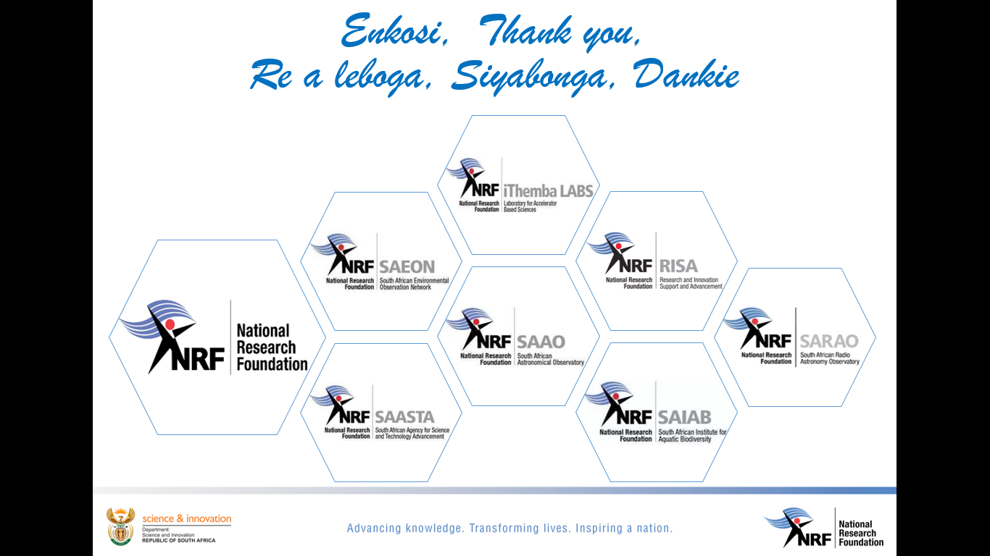

Slide 40
Impact of Science
23-25 June, 2021
Thank you
#IOS21

